Slide 1
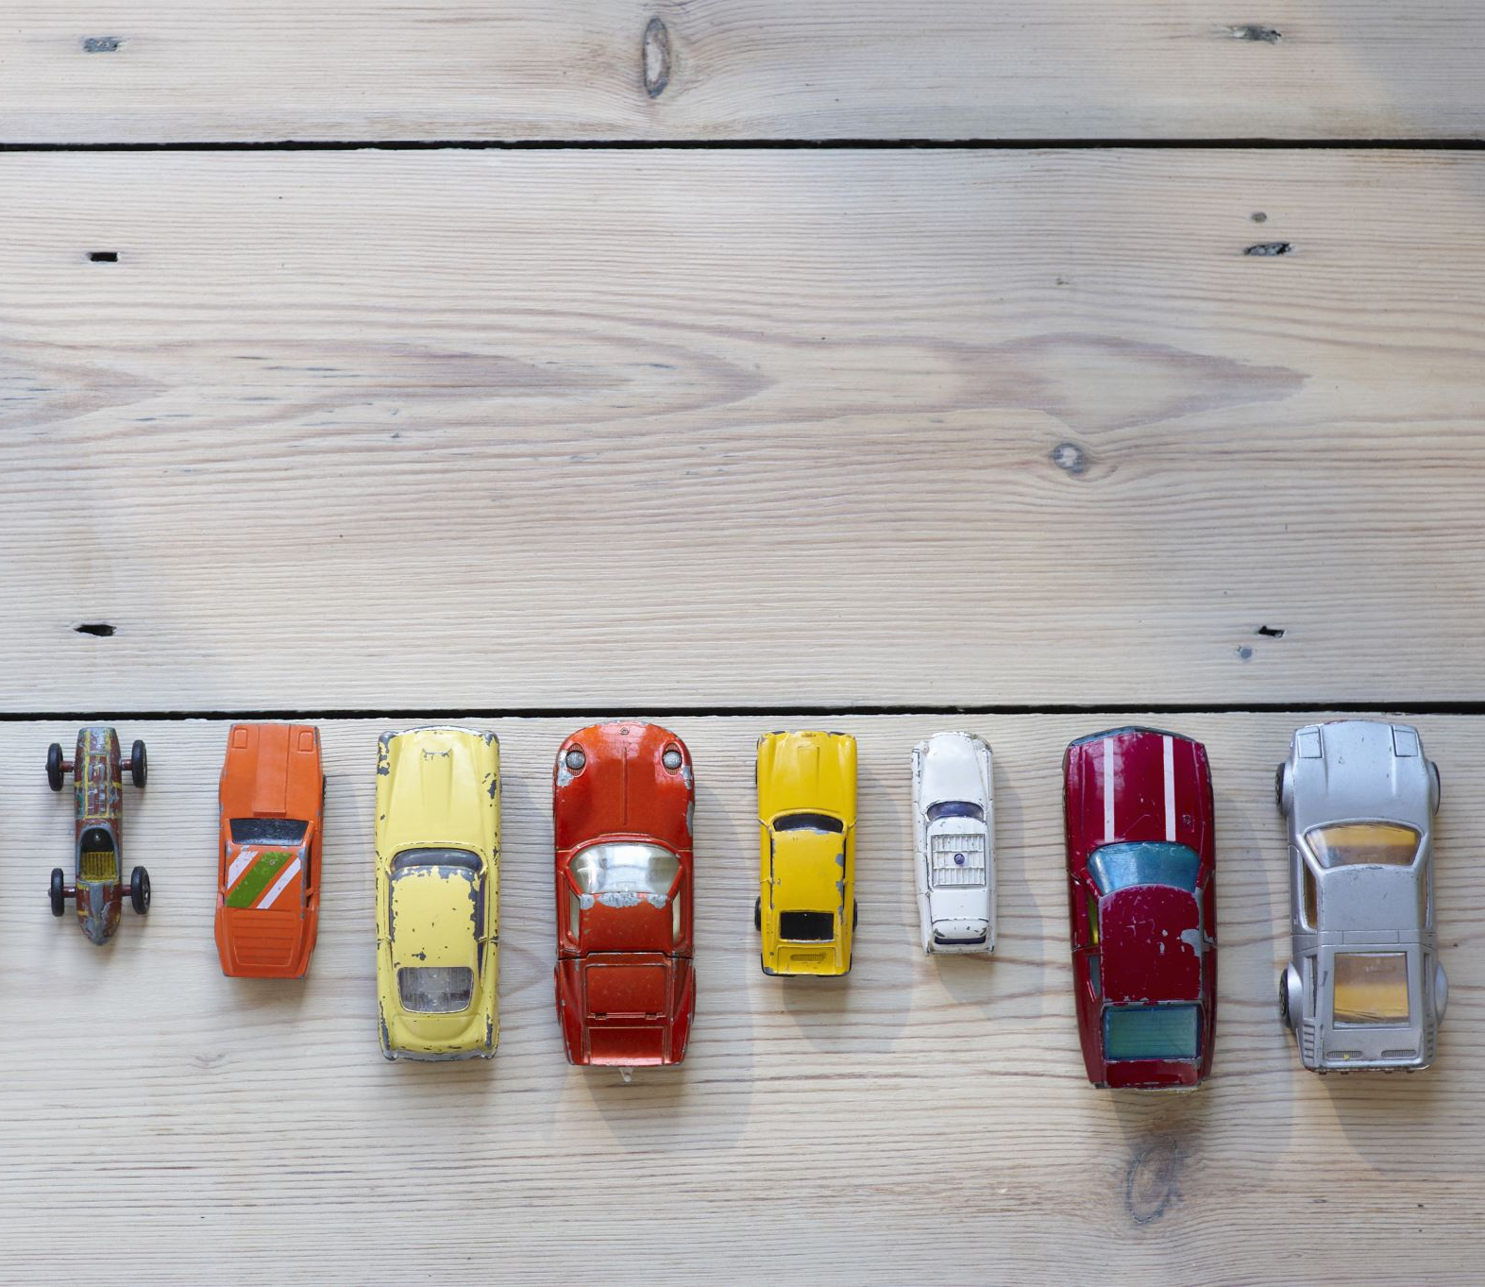
Auto Insurance Rate Prediction Model
Raj Ponnam
Final Project – DSC 530
Bellevue University

Slide 2
Problem Statement and Research Questions
Problem Statement:
Determine how insurance companies predict the risk of each individual based on potential for claims and offer them appropriate auto insurance rate.
Research Questions:
Does number of kid drivers in the household increase claim risk?
Does age of the driver increase claim risk?
Does marital status put individual in high risk driver category?
Does past high claims frequency put individual in high risk driver category?
Does history of suspended license impact auto rate?

Slide 3
Types of variables
KIDSDRIV – Number of kid drivers per household. It has integer value.
AGE – Age of the driver between age of 16 years - 99 years. It has integer value.
MSTATUS - Material status of the driver. It has integer value. ‘Yes’ has value of 1 and ‘No’ has value of 0.
CLM_FREQ – Claim frequency of the driver. Variable will give you how many claims customer had in the past few years. Value is integer.
REVOKED – If the driver has revoked license then the value is 1, if not the value is 0.
CLAIM_FLAG - Claim Flag on the driver’s policy. If there is flag, value is 1 and if no flag it is 0. This variable is the outcome variable.

Slide 4
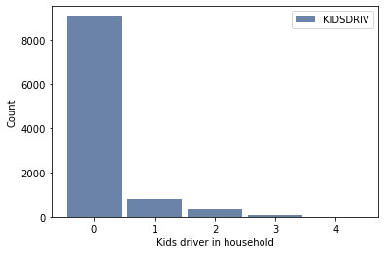
Analysis of ‘KIDSDRIV’ variable
KIDSDRIV variable represent kids driver per household
Following is analysis of KIDSDRIV variable
Range = 0 to 4
Outlier = 4
Mean = 0.17
Median = 0
Mode = 0

Slide 5
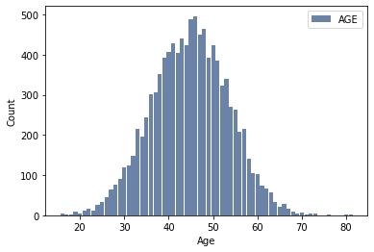
Analysis of ‘AGE’ variable
AGE variable represents age of the driver
Following is analysis of AGE variable
Range = 16 to 81
Outlier = None
Mean = 44.84
Median = 45
Mode = 46

Slide 6
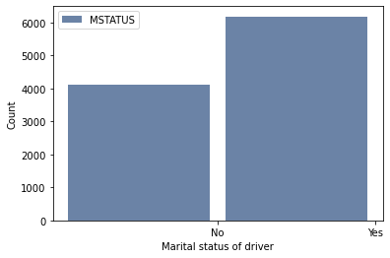
Analysis of ‘MSTATUS’ variable
MSTATUS variable represents marital status of the driver
MSTATUS is binary variable
Value of the MSTATUS variable is Yes or No

Slide 7
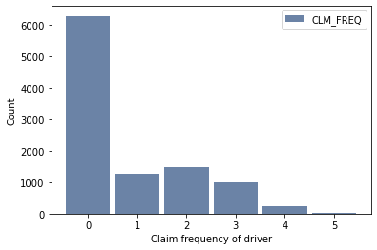
Analysis of ‘CLM_FREQ’ variable
CLM_FREQ variable represents claim frequency of the driver
Following is analysis of CLM_FREQ variable
Range = 0 to 5
Outlier = 0
Mean = 0.80
Median = 0
Mode = 0

Slide 8
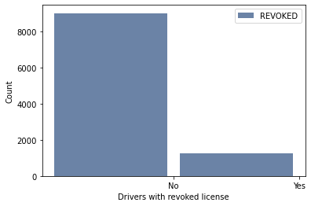
Analysis of ‘REVOKED’ variable
REVOKED variable represents whether license is revoked or not.
REVOKED is binary variable
Value of the REVOKED variable is Yes or No

Slide 9
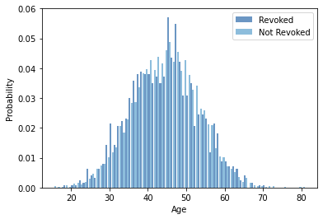
PMF – Revoked status compared with age
By looking at the graph it looks like younger people tend to have more revoked licenses than older people

Slide 10
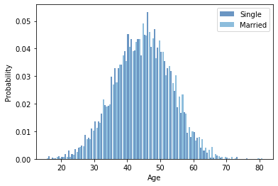
PMF – Marital status compared with age
By looking at the graph it looks like single people tend to be younger and married people tend to be older.

Slide 11
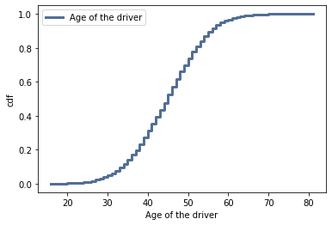
CDF – Age of the Driver
By looking at the graph it looks like perfectly normal distribution
Most of the drivers are in the range of 35 years to 60 years of age

Slide 12
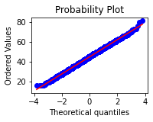
Normal Probability Plot – Age
By looking at the graph it looks like perfectly normal probability plot
The plot matches the model near the mean and is consistent through several standard deviations with slight deviation in the tails

Slide 13
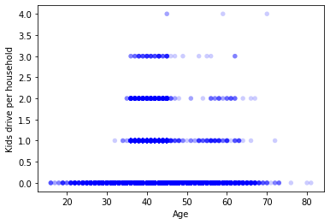
Scatterplot – Age and Kids Driver
By looking at the scatterplot, it indicates that there is no relationship between age and kids driver per household.
The Correlation Coefficient is -0.08 which indicates that the relationship is not significant.

Slide 14
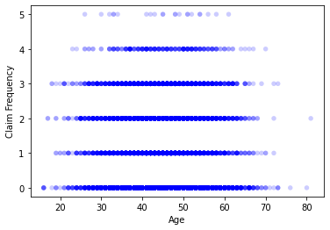
Scatterplot – Age vs Claims Frequency
By looking at the scatterplot, it indicates that there is no relationship between age and claim frequency
The Correlation Coefficient is -0.04 which indicates that the relationship is not significant.

Slide 15

Hypothesis Testing
Hypothesis testing - does age contribute to the claims frequency?
NULL hypothesis – age does not contribute to claim frequency
P-Value is 0.00 which indicates that the relationship is statistically significant
NULL hypothesis should be rejected
Age contributes to claim frequency

Slide 16
Regression Analysis
Variable | Coef | P-Value
MSTATUS | -0.5284 | 0.00
REVOKED | 0.8777 | 0.00
AGE | -0.0224 | 0.00
KIDSDRIV | 0.4131 | 0.00
CLM_FREQ | 0.3877 | 0.00
Regression model is showing correlation and P-Value of each variables. Each variable is compared with CLAIM_FLAG predicator variables and following analysis is done on depended variable

Slide 17
Regression Analysis
Variable | Statistically Significant? | Relationship
MSTATUS | YES | High Negative
REVOKED | YES | High Positive
AGE | YES | No relation
KIDSDRIV | YES | High Positive
CLM_FREQ | YES | High Positive

Slide 18

Thank you

